Slide 1
Project 1: Interim Presentation
By: Kayla Robledo
February 18th, 2026

Slide 2
Research Questions
From baseline to year 2 after starting highly active antiretroviral treatment (HAART)...
Do viral load counts decrease? Is there a difference between those who use hard drugs at baseline and those who do not?
Do CD4+ T cell counts decrease? Is there a difference between those who use hard drugs at baseline and those who do not?
Do physical quality-of-life scores increase? Is there a difference between those who use hard drugs at baseline and those who do not?
Do mental quality-of-life scores increase? Is there a difference between those who use hard drugs at baseline and those who do not?

Slide 3
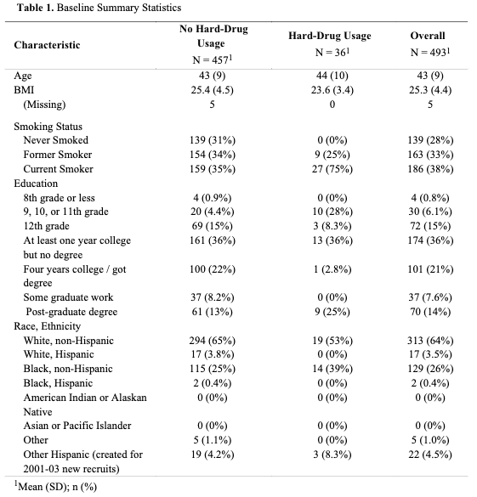
Data Overview and Descriptive Statistics
Which covariates should be baseline only?
How should we proceed with grouping race/ethnicity? White, black, other?
Can we group education at 8th grade or less and 9th, 10th, or 11th grade?
Since viral load counts and CD4+ T cell counts are right skewed, a log transformation will be needed
Data cleaning process:
Exlcude data to years 0 and 2 where each individual has observations for both
Exclude negative BMIs and BMIs exceeding 250
Viral load and CD4+ T cell counts are missing 28 and 27 values respectively. Both quality of life measures are missing 7.
Overall, 1 observation is missing smoking status and 57 are missing BMIS

Slide 4
Analysis Plan
4 different linear models:
  Outcomes: log(viral load), log(CD4+ T cell counts), physical quality-of-life, mental-quality-of-life
  Primary explanatory variable: baseline hard drug usage
  Covariates: baseline outcome, age, BMI, smoking status, race/ethnicity, adherence, education
One conventional model for each outcome
  Report: point estimates, 95% confidence intervals, p-values
One Bayesian model for each outcome
  Non-informative priors for regression parameters
  Report: point estimates, 95% highest posterior density intervals
Evidence of an association would be determined by a p-value < 0.05 or the respective 95% intervals excluding 0
We are interested if there is a difference in the outcome from baseline to year 2 for individuals who reported using hard drugs at baseline compared to those who did not
  We want to quantify that difference and determine if there was an increase or decrease in the outcomes

Slide 5
Questions/Comments

